Slide 1
CUSTOMER SATISFACTION ANALYSIS FOR EMIRATES AIRLINE
Springboard Capstone Project
Palak Batra

Slide 2
Motivation
Airline is a service industry, so customer satisfaction is an important metrics.
The rating for Emirates airline is quite low (6/10)
Emirates needs to know where its investment in service improvement would be most profitable.
Supervised learning models may help to find these features and quantitative metrics for improvement.

Slide 3
Data
Reviews of airline travelers on Skytrax
Number of observations: 961
Attributes: 20
Types of data: ordinal (rating), text (reviews), binary (recommended)
The ratings for each attribute range from 1 to 5, while overall rating
is from 1 to 10

Slide 4
Data Wrangling Approach
Only choose data since 2010
Drop data without overall rating
Drop information that is not needed for modelling purpose: link, title, author, author country, date, content, aircraft type, route, recommended
Encode missing values as 0
Get dummies for traveller type and cabin flown

Slide 5
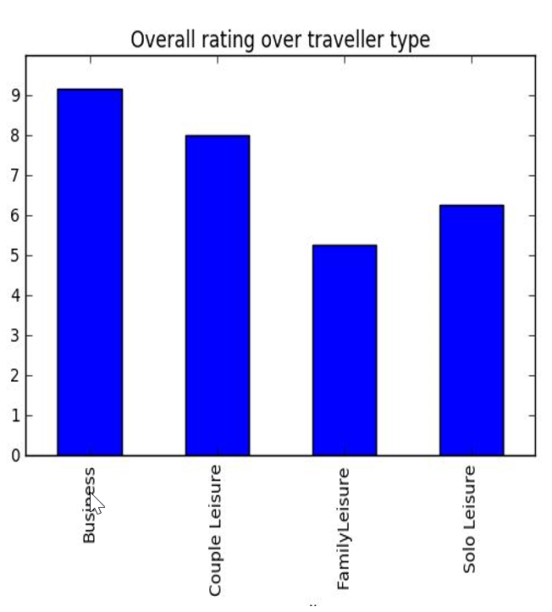
Descriptive
Business and couple show much more preference in Emirate services than family and solo traveler

Slide 6
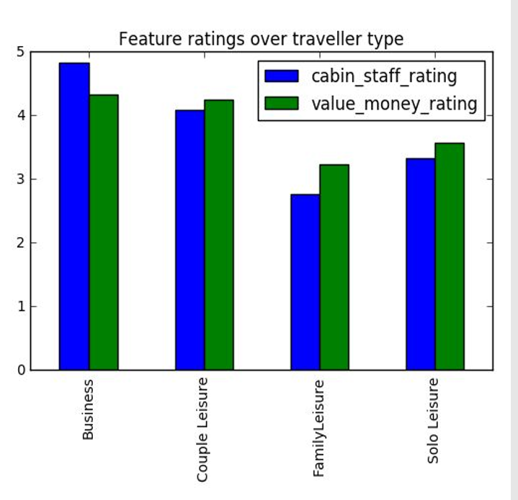
Descriptive
Business and couple also value cabin staff and value money rating higher than the other two groups. This is statistically significant at 1%

Slide 7
Modelling
First, I build a model that can predict well the overall rating based on each feature's rating. Classifiers: OLS Linear model, Ridge regression and random forest.
Then, select the best model
Finally, the final reference table together with the chosen model and cost benefit analysis, Emirates airlines can build a good strategy on where to invest their resources to achieve better customer satisfaction and profits.

Slide 8
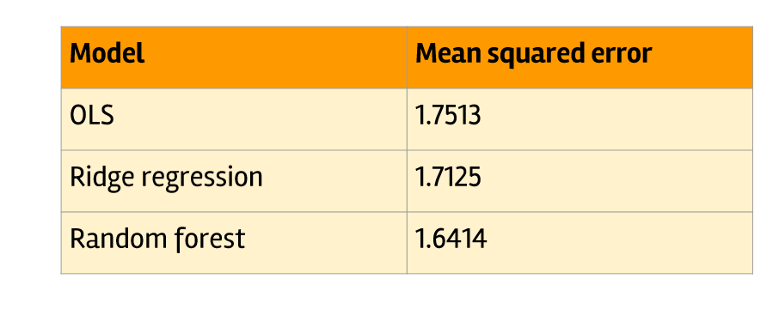
Result
Random forest has the best performance among the 3 models.

Slide 9
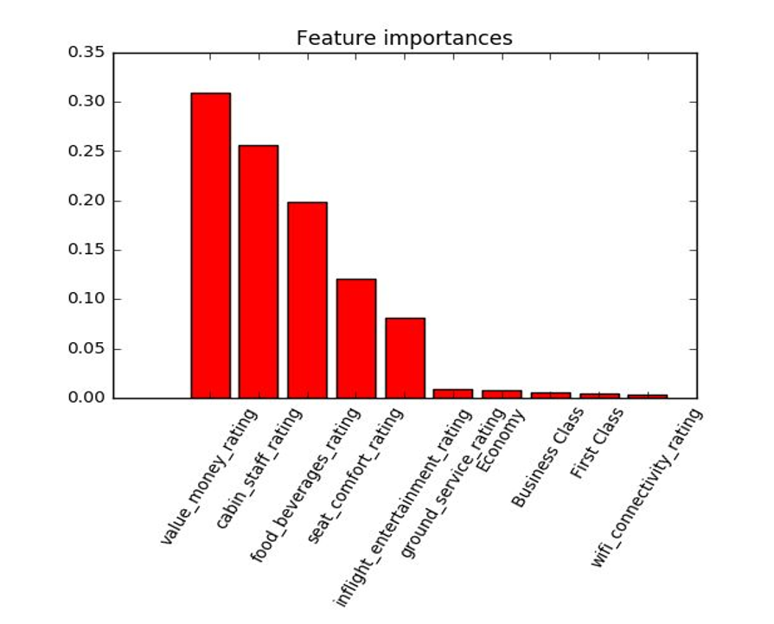

Slide 10
Recommendations
Based on its corporate strategy and cost benefit analysis, Emirates may use the reference table and Random forest model to plan their target for improvement in some services.
While pricing is related closely with business strategy and positioning, Emirates might find it easier to improve its cabin staff and food beverages while still have huge effect on overall rating.

